Slide 1
Find it Friday
A Story about CAR’S Scavenger Hunts
by Shannon Sousa, MS, CCC-SLP of Community Autism Resources

Slide 2
Every Friday I get to go on a scavenger hunt. A scavenger hunt is when you search to find items. The scavenger hunt is called “Find it Friday.”

Slide 3
Lots of kids are celebrating “Find it Friday” at their houses.

Slide 4
I will look around my house and find items on the list.

Slide 5
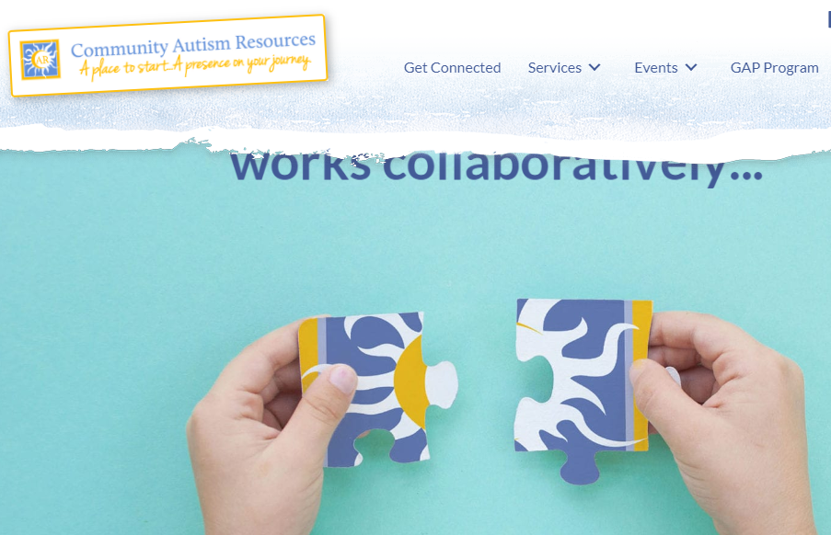
After I find all the items, I will take a picture to share with CAR.

Slide 6
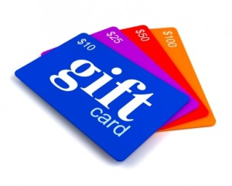
Every week, there is one prize that one kid will win. The prize is a gift card to a special place.

Slide 7
All of the kids’ names go into a jar and one winner is picked.

Slide 8
If my name is not picked, it is okay to feel disappointed. There is only one prize.

Slide 9
I will try again next week.

Slide 10
Scavenger hunts are so much fun!

